Slide 1
Topic 4.1 Choosing an Operating System
C851 Cohort Live Session for Sunday, October 3, 2021
Dr. John S. Galliano | C851 Linux Foundations Instructor

Slide 2
Agenda
Welcome
Upgraded C851
Format Comparison
The New Labs
Demos
About the Exam
The 5 Exam Domains
Wrap-Up

Slide 3

About the Linux Essentials v1.6 [1]
The 5 Exam Domains [3]
No prerequisites
Closed book, up to 60 minutes
40 multiple-choice (some multi-select and fill-in-the-blank items) questions
Min pass score 500 points (200-800 scale)
Partially correct responses not accepted (for F-I-T-B questions LPI may accept multiple correct versions of an answer [2]
Total exam weight count is 40, thus 40 questions
The Linux Community and a Career in Open Source
Finding Your Way on a Linux System
The Power of the Command Line
The Linux Operating System
Security and File Permissions
[1,3] Linux Professional Institute, “Linux Professional Institute Linux Essentials,” Linux Professional Institute, 21-Oct-2018. [Online]. Available: https://www.lpi.org/our-certifications/linux-essentials-overview. [Accessed: 14-Aug-2021]
[2] Dr. Galliano’s correspondence with LPI, dated August 2021: Example: with/without leading path in a case where the answer is a command
Notes:
Examples:
• If an objective has a weight of 4, there will be 4 questions on the exam related to that objective [2]
Links:
• View the 3rd party cert tips video at https://bit.ly/3party_cert_tips

Slide 4

LPI Exam Re-Take Policy [4]
Anyone who takes an LPI exam once must wait one week before re-taking
Anyone who takes an LPI exam a second (and subsequent) time must wait 30 days before re-taking
3rd and subsequent attempts at your own cost ($120)
[4] Linux Professional Institute, “Privacy Statement and Policies,” Linux Professional Institute, 18-May-2018. [Online]. Available: https://www.lpi.org/policies. [Accessed: 14-Aug-2021].
Notes:
• Anyone who passes an LPI exam may not retake that exam for two years

Slide 5

Exam Topics/Weightings
Linux Essentials v1.6 Exam Topics [5] | 1.1 | 2
 | 1.2 | 2
 | 1.3 | 1
 | 1.4 | 2
 | 2.1 | 3
 | 2.2 | 2
 | 2.3 | 2
 | 2.4 | 2
 | 3.1 | 2
 | 3.2 | 3
 | 3.3 | 4
 | 4.1 | 1
 | 4.2 | 2
 | 4.3 | 3
 | 4.4 | 2
 | 5.1 | 2
 | 5.2 | 2
 | 5.3 | 2
 | 5.4 | 1
 |  | 40
[5] Linux Professional Institute, “Linux Essentials Objectives V1.6 - LPI Wiki,” Linux Professional Institute, 25-Jan-2020. [Online]. Available: https://wiki.lpi.org/wiki/Linux_Essentials_Objectives_V1.6. [Accessed: 14-Aug-2021].
Notes:
• A weight of “1” equates to 1 exam question
• Since there is a weight of ‘1’, you will see 1 question on this topic!

Slide 6

4.1 Choosing an Operating System [6]
Weight: 1 (1 question)
Key Knowledge Areas:
Differences between Windows, macOS, and Linux
Distribution life cycle management
Files used, terms and utilities:
GUI versus command line, desktop configuration
Maintenance cycles, beta and stable
[6] Linux Professional Institute (LPI), “Exam 010 Objectives,” Linux Professional Institute, 21-Oct-2018. [Online]. Available: https://www.lpi.org/our-certifications/exam-010-objectives. [Accessed: 10-Jul-2021].
Notes:
Commands (‘#’ denotes a comment):
• None
Links:
• https://explainshell.com/ to learn about commands, options, arguments
• https://github.com/g33k247/851 for Dr. Galliano’s GitHub repo of study resources

Slide 7
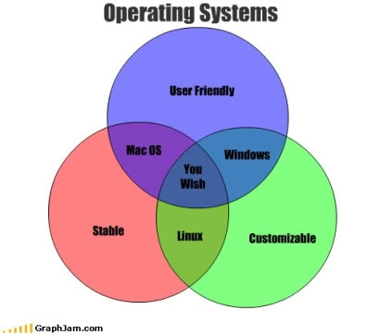
Differences between Windows, macOS, and Linux [7]
Differentiate between major operating systems
Differentiate reasons for the use of both the graphical user interface (GUI) and command line
Identify major open-source applications and uses
List major distros (the family tree)
[7] A. Heroe, “Operating Systems,” Pinterest. [Online]. Available: https://www.pinterest.com/pin/61431982390617050/. [Accessed: 02-Oct-2021].
Notes:
Important to know for the exam:
• Commercial vs. Open Source
• Locked down vs accessible
• Source code available
• What is a distro?
Commands (‘#’ denotes a comment):
• None

Slide 8
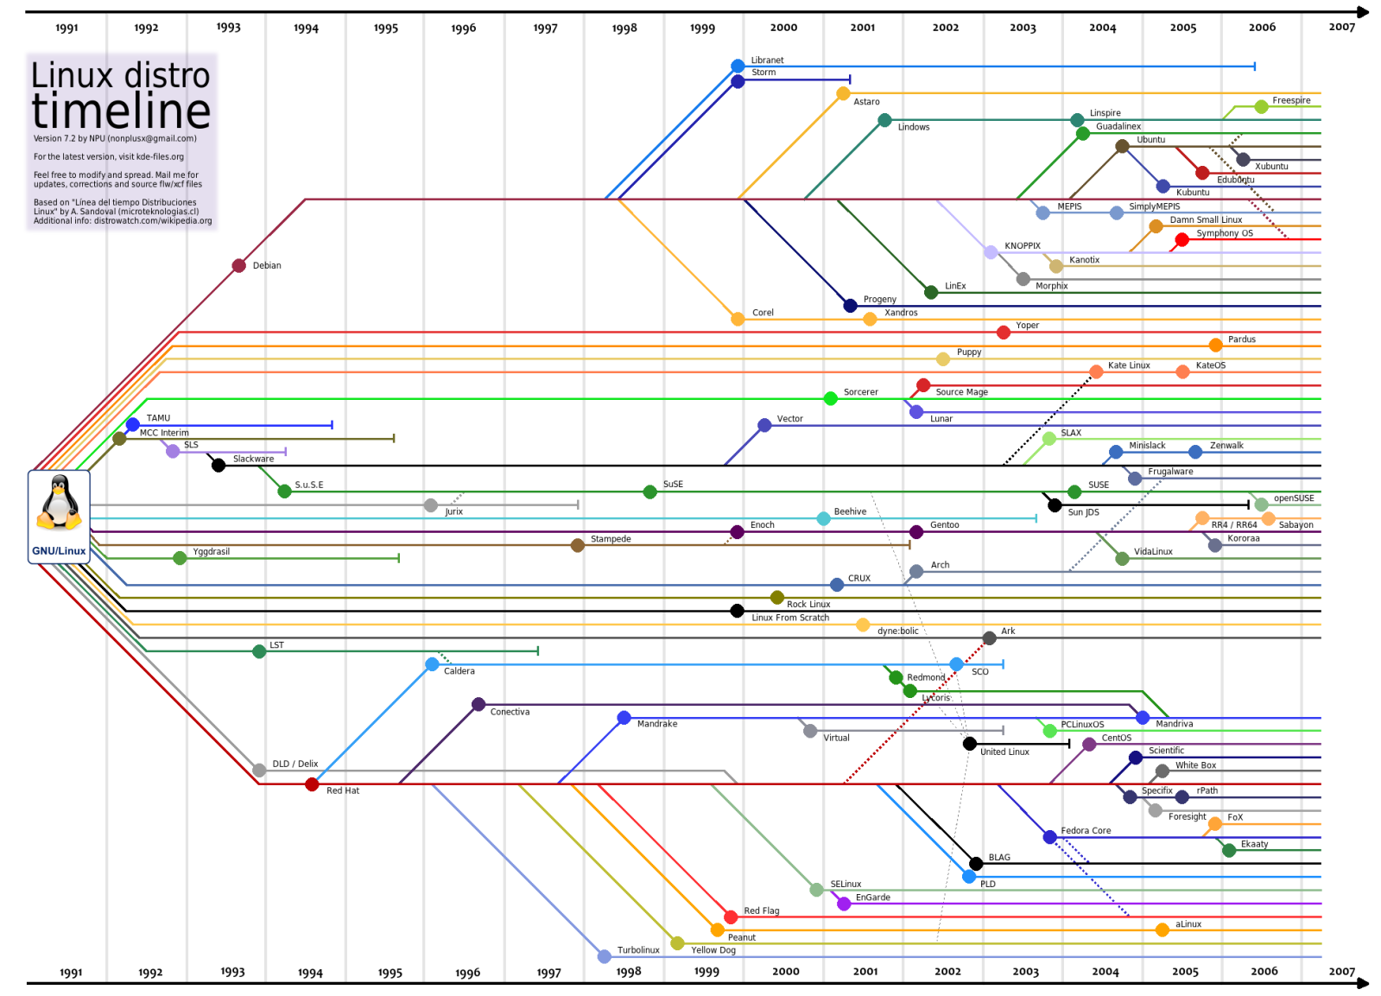
1.1 Linux Evolution and Popular Operating Systems
DEBIAN
SLACKWARE
ARCH
RED HAT
[8] A. Lundqvist, D. Rodic, M. Mustafa, M. Herdiansyah, and F. Loli, “GNU/Linux Distributions Timeline v20.10,” Wikipedia, 25-Oct-2020. [Online]. Available: https://upload.wikimedia.org/wikipedia/commons/1/1b/Linux_Distribution_Timeline.svg. [Accessed: 14-Aug-2021].
Notes:
Debian
• Debian
• Ubuntu
• Mint
• Kali
Red Hat
• Red Hat
• CentOS
• Fedora
• Scientific Linux
Others
• Arch, Slackware

Slide 9
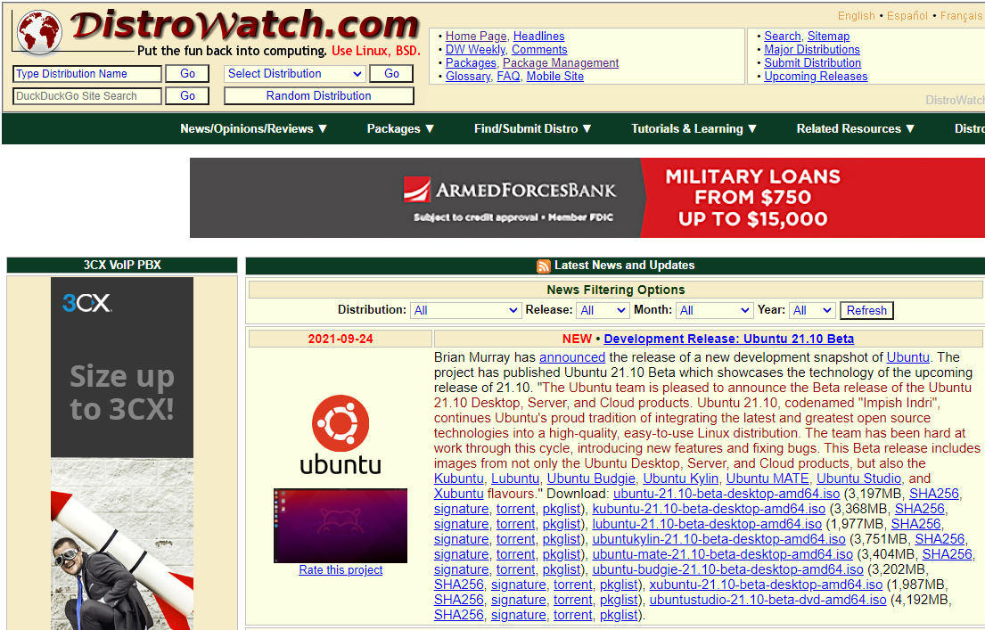
What is an Operating System?
A Linux Distro =
The Linux kernel
The GNU utilities
GUI components (WDM, DE, etc.)
Applications
Enterprise Grade Linux Distros:
RHEL, CentOS, SUSE Linux Enterprise
Debian GNU/Linux
Ubuntu LTS
Consumer Grade Linux Distros:
Fedora, Ubuntu (non-LTS), openSUSE
Mint, Deepin, Elementary, Zorin
Experimental/Hacker Linux: Distros:
Arch, Gentoo, KALI, parrot
DYK? The Linux kernel was first developed by Linus Torvalds, a student from Finland, back in 1991. In 1992, the first Kernel release under the GNU General Public License version 2 (GPLv2) was version 0.12.
Notes:
Commands (‘#’ denotes a comment):
• None

Slide 10
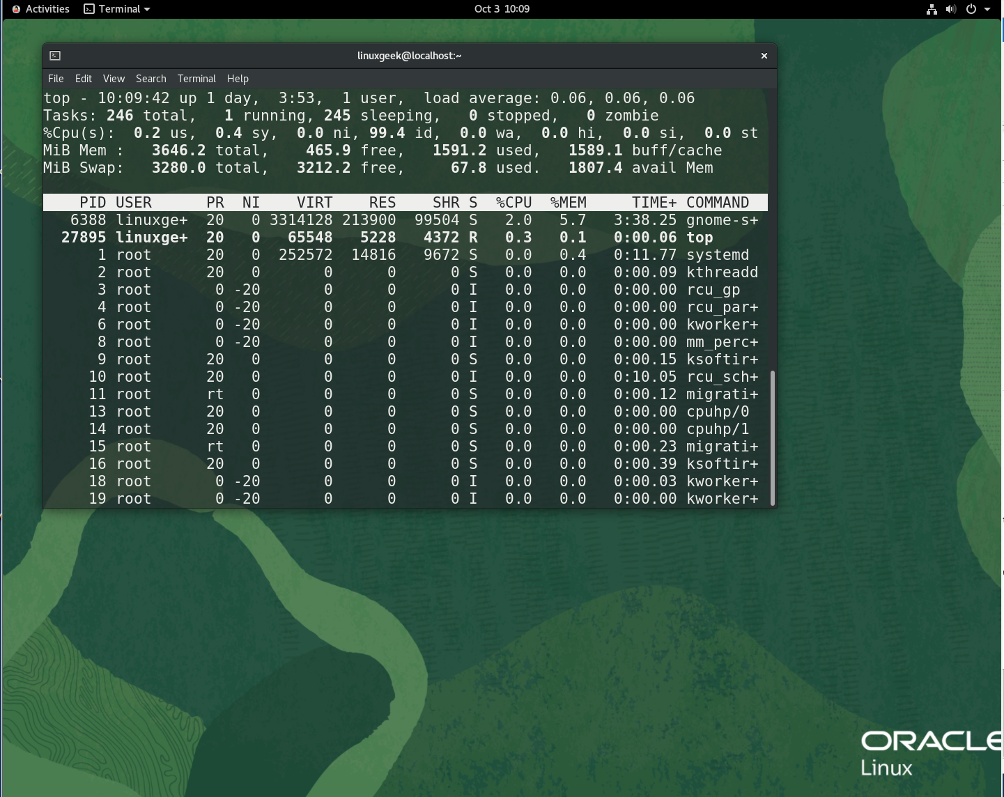
Distro life cycle management [7]
GUI versus command line, desktop configuration
Maintenance cycles
Ubuntu uses date-based versioning
19.04 = April 2019 release
Beta and stable
Rolling vs monolithic
[7] A. Prakesh, “Linux Directory Structure Explained For Beginners,” Linux Handbook, 26-Jun-2019. [Online]. Available: https://linuxhandbook.com/linux-directory-structure/. [Accessed: 26-Sep-2021].
Notes:
Important to know for the exam:
• Examples of ‘LTS’ distros (e.g., Ubuntu LTS, CentOS, etc.)
• Why choose an LTS distro? Best for corporate/enterprise due to higher security, stability, support
Commands (‘#’ denotes a comment):
• None

Slide 11









Today’s Popular Distros
Arch Linux
Debian
Elementary OS
Fedora
Linux Mint
Manjaro
Pop!_OS
KALI
Ubuntu
Notes:
Important to know for the exam:
• Red Hat distros include Red Hat Enterprise Linux (RHEL), CentOS, Fedora, Scientific Linux
• Debian distros include Debian, Ubuntu, Mint, Kali
Commands (‘#’ denotes a comment):
• None
Links:
• www.distrowatch.com to research distros, link to downloads, etc.
• distrochooser.de/en/ to help you determine what you need
• distrotest.net/index.php to take a distro for a test drive

Slide 12
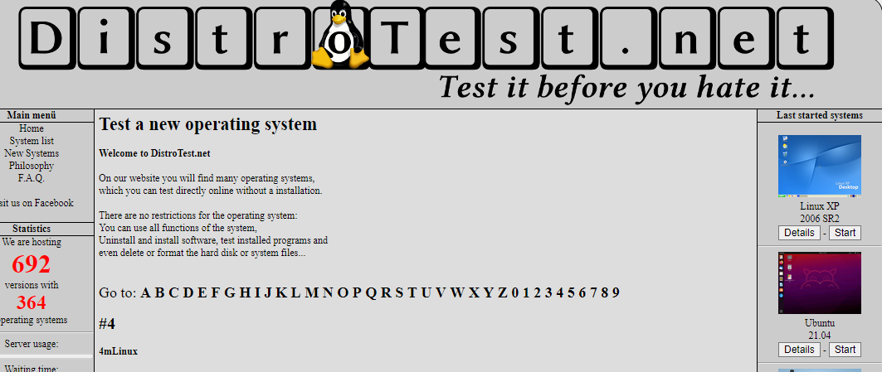
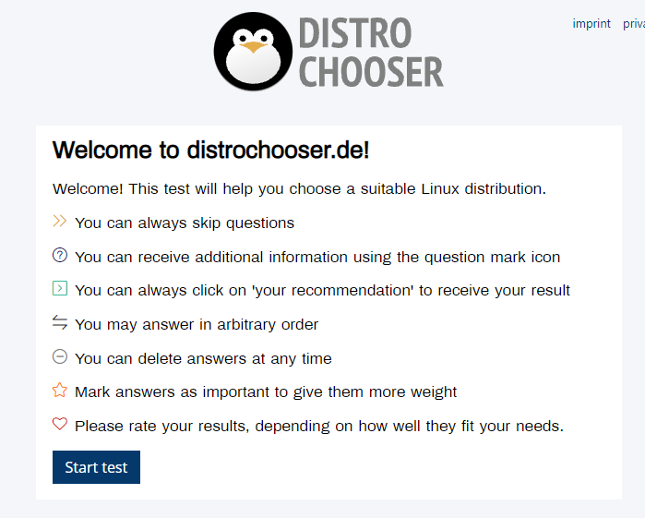
Choosing a Distro
How Do I Choose the Right Distro?
Linux distros are purpose built
DYK? The Linux kernel was first developed by Linus Torvalds, a student from Finland, back in 1991. In 1992, the first Kernel release under the GNU General Public License version 2 (GPLv2) was version 0.12.
Notes:
Commands (‘#’ denotes a comment):
• None
Links:
• www.distrowatch.com to research distros, link to downloads, etc.
• distrochooser.de/en/ to help you determine what you need
• distrotest.net/index.php to take a distro for a test drive

Slide 13
Applications
Microsoft office > LibreOffice
Notepad > nano, pico, vim/vi
Access > LibreOffice Base
Visio > Calligra Flow, LibreOffice Draw
PowerPoint > LibreOffice Impress
Outlook > Thunderbird
Photoshop > GIMP
Evernote > Joplin
Adobe Acrobat > Evince

Slide 14

Demos
Based on Red Hat Enterprise Linux (RHEL)
Oracle Linux is an open-source clone
Did You Know? Oracle’s Linux distro is a clone of RHEL and used in the Oracle Cloud Infrastructure (OCI).
Notes:
Commands (‘#’ denotes a comment):
uname -r #check Linux kernel version
uname -s #check OS proper name
uname -a && cat /etc/*eleas* #get all detaisla bout the kernel, OS, and release notes
sudo lshw #get info on hardware
sudo lshw -html > lshw.html #send output to a nicely formatted html file
firefox lshw.html
sudo lscpu #get cpu info
sudo lspci #get pic device info
sudo lsusb #get usb device info
sudo lsblk -a #get drives info
sudo fdisk –l #get drives info
sudo dmidecode -t system #get kernel info
sudo dmidecode -t bios #get bios info
sudo dmidecode -t memory #get memory info
sudo dmidecode -t processor #get cpu info
sudo dmesg --follow #tail kernerl messages
sudo dmesg | grep -i usb #get messages on usb devices

Slide 15

Notes:
Interested?
• Contact the email address or connect via social media links at the bottom of the graphic
• Mention that you were referred by Dr. Galliano.

Slide 16

Notes:
Interested?
• Go to https://certs.comptia.org/fallscholarship/ and apply today!

Slide 17
What Questions Do you Have for Me?

